Slide 1
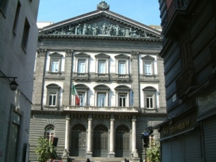
EDUCATIONAL SYSTEM IN ITALY
“Country you go, custom you find or, in this case, education you find!”
Although many countries try to standardize their educational system, today we still find many differences in the world and also about Italy. According to the new reform, our current school system is so divided:
PRESCHOOL PRIMARY SCHOOL SECONDARY SCHOOL ( LOWER AND UPPER SECONDARY) UNIVERSITY

Slide 2
PRESCHOOL
The cycle begins with the pre-education for children aged 2.5 to 6 years
that is not compulsory and can freely last three years.
After this, the compulsory education starts and that includes: primary and secondary education (level I and level II).
PRIMARY SCHOOL
Currently, the duration of primary school (once called elementary school) is 5 years for children aged 6-7 years.
Till the last year the education was planned through a didactic form with some teachers interchanging in the 3 or 4 classrooms while with the new reform of Elementary School we can find one teacher per class too, and with no final examination (leaving certificate) to pass in the secondary school.

Slide 3
SECONDARY SCHOOL
The secondary school last long 8 years so subdivided:
3 years in the first degree and 5 years in the second.
LOWER SECONDARY SCHOOL
The first degree corresponds to the old “Middle School”.
Typically school time ranges from 29 to 33 hours per week and the subjects are usually: Italian, History, Geography, Mathematics, Science, Technology, English language, Art, Music, Physical Education and Catholic Religion (optional).
Besides, students optionally can add 4 hours for laboratory according to the school resources. At the end of the third year, pupils sit a standard examination. Successful students are awarded their lower secondary school diploma (diploma di licenza media) and can move on to upper secondary school.

Slide 4
UPPER SECONDARY SCHOOL
The State Upper Secondary education is offered by the so called 1) lycei, 2) the technical institutes, 3) the vocational institutes, and 4) the arts institutes.
The overall length of study is 5 years (from 14 to 19 years of age). The first two years are mandatory or, at least, until the sixteenth year of the student.
Education offered by the lyceum aims at preparing students for university studies, whereas the main purpose of technical education is to give pupils specific theoretical and practical preparation for skilled tasks. Artistic institutes prepare pupils for work and artistic production.
In the vocational education, after the first two years, the students must do a final qualifying examination that allows them to stop their studies, however getting a professional certificate, or to go on studying till the high school leaving qualification.
.

Slide 5
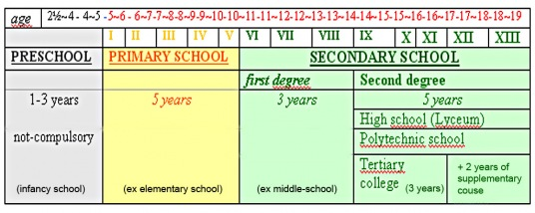
UNIVERSITY
At last, students can attend University whose cycle of study is so articulated:
a sort of Bachelor’s degree lasting 3 years (we call it short Degree)
to get a Master’s Degree other 2 years are needed
for a Ph. D. or post-graduate studies other 2-5 years according to the subject.
Both Bachelor and Master’s degree end with the graduation thesis.

Slide 6
The Ministry of Education, Universities and Research (Ministero dell'Universitá e della Ricerca) is responsible for administration of state schools. According to the legal form we have state schools or public schools, private schools and officially recognized schools while the professional education is regulated by the Regions.
In the state schools or public schools there are tuition fees to pay every year that are much lower than those in private schools. On the contrary, academic fees are quite expensive specially for private universities.

